Slide 1





Exploring the Opportunities
Offered by COST Projects
Prof. dr. Amra Bratovcic
Science Communication Coordinator
https://amrabratovcic.com/
CA23123
Non-chemical weed management in
medicinal and aromatic plants (MAPs) (weedingMAPs)
UNTZ-09.03.2026.
Tuzla, Bosnia and Herzegovina

Slide 2
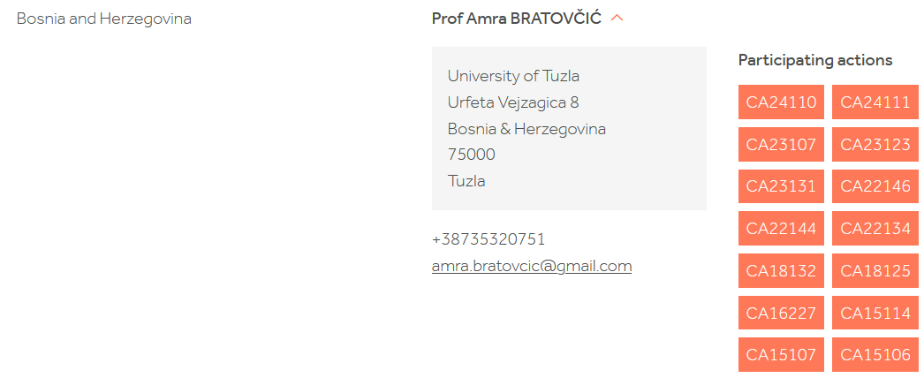

List of the participation actions
14

Slide 3
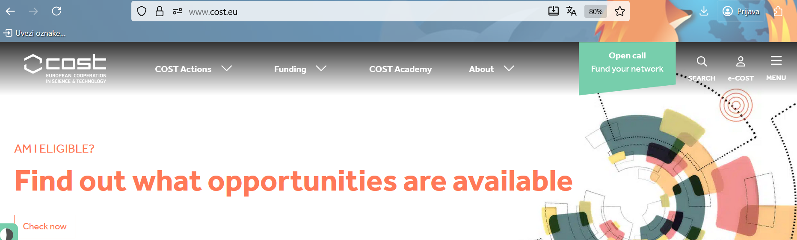
What is a COST Action?
www.cost.eu

Slide 4
A CA is an interdisciplinary research network that brings together researchers and innovators to investigate a topic of their choice for 4 years.
Key Features | Opportunities for Researchers
Open to all science and technology fields Brings together experts from: Academia SMEs* Public institutions Other relevant organisations and stakeholders Encourages collaboration and knowledge exchange across Europe | Build and expand professional research networks Work in an European environment Boost career development through international collaboration
*SMEs Small and Medium-sized Enterprises

Slide 5
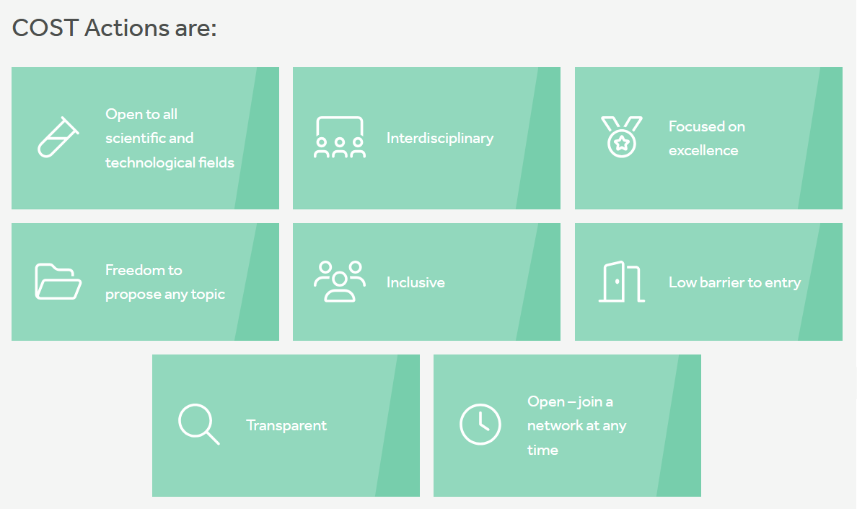

Slide 6
Why COST Actions Matter in Today’s Research Landscape?
The Modern Research Landscape
Research today must be:
Interconnected
Interdisciplinary
Collaborative
Data-intensive
How COST Actions Contribute?
Focus on networking activities rather than funding research directly
Enable researchers to:
Share ideas, data, and methods
Tackle complex problems collaboratively
Engage across a wide geographical area

Slide 7
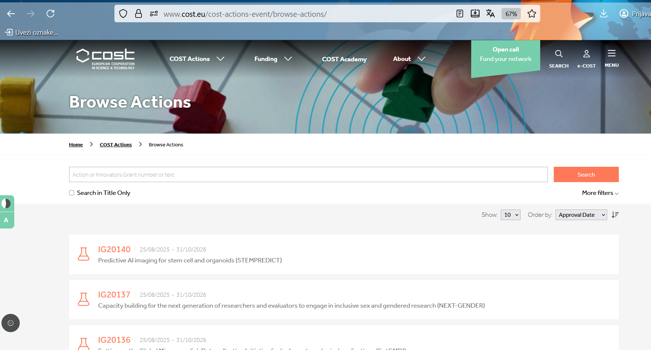
Browse Actions
https://www.cost.eu/cost-actions-event/browse-actions

Slide 8
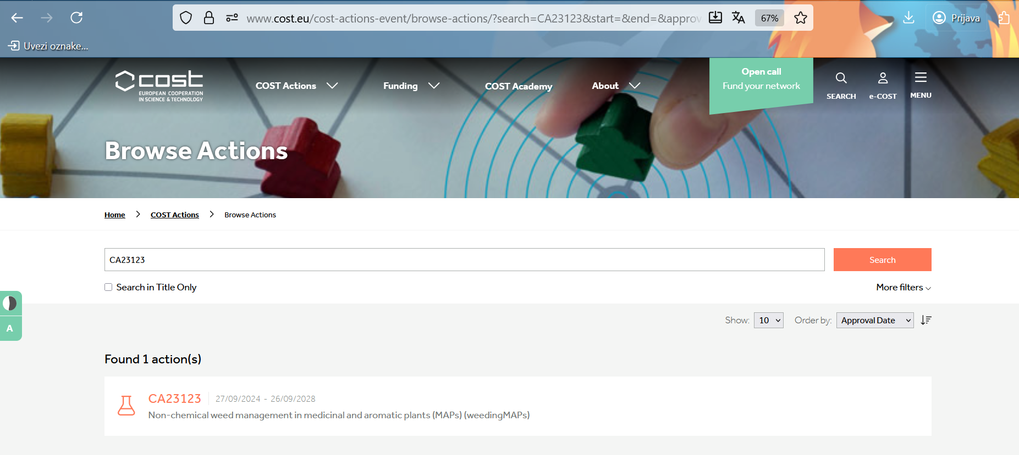

Slide 9
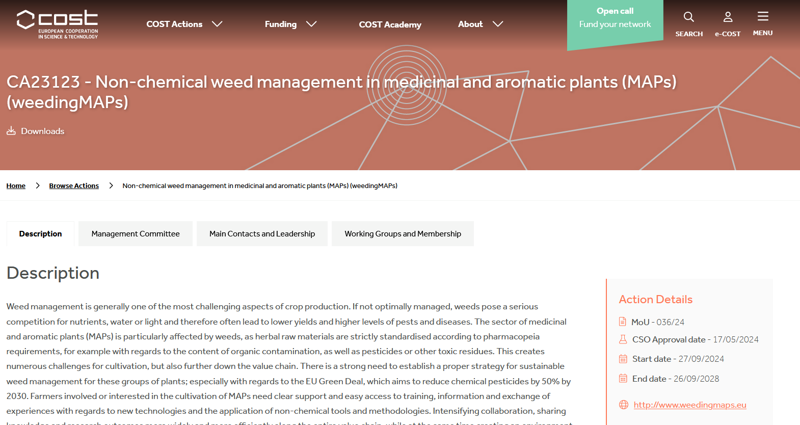
CA23123 - Non-chemical weed management in medicinal and aromatic plants (MAPs) (weedingMAPs)
https://www.cost.eu/actions/CA23123/

Slide 10
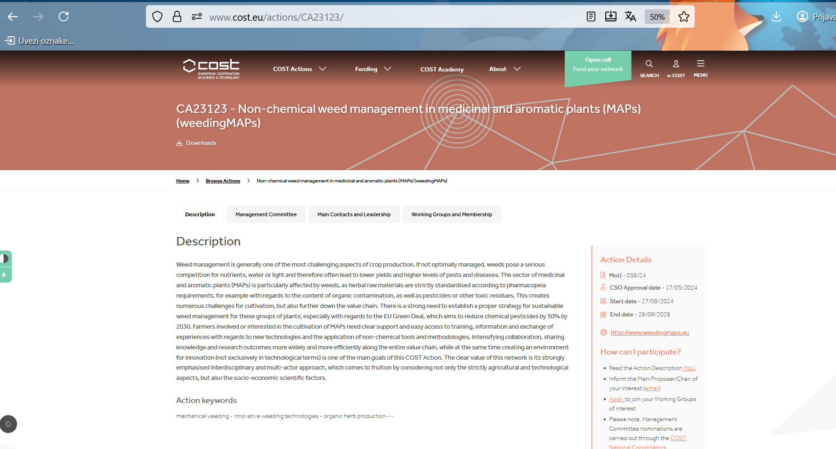

Slide 11
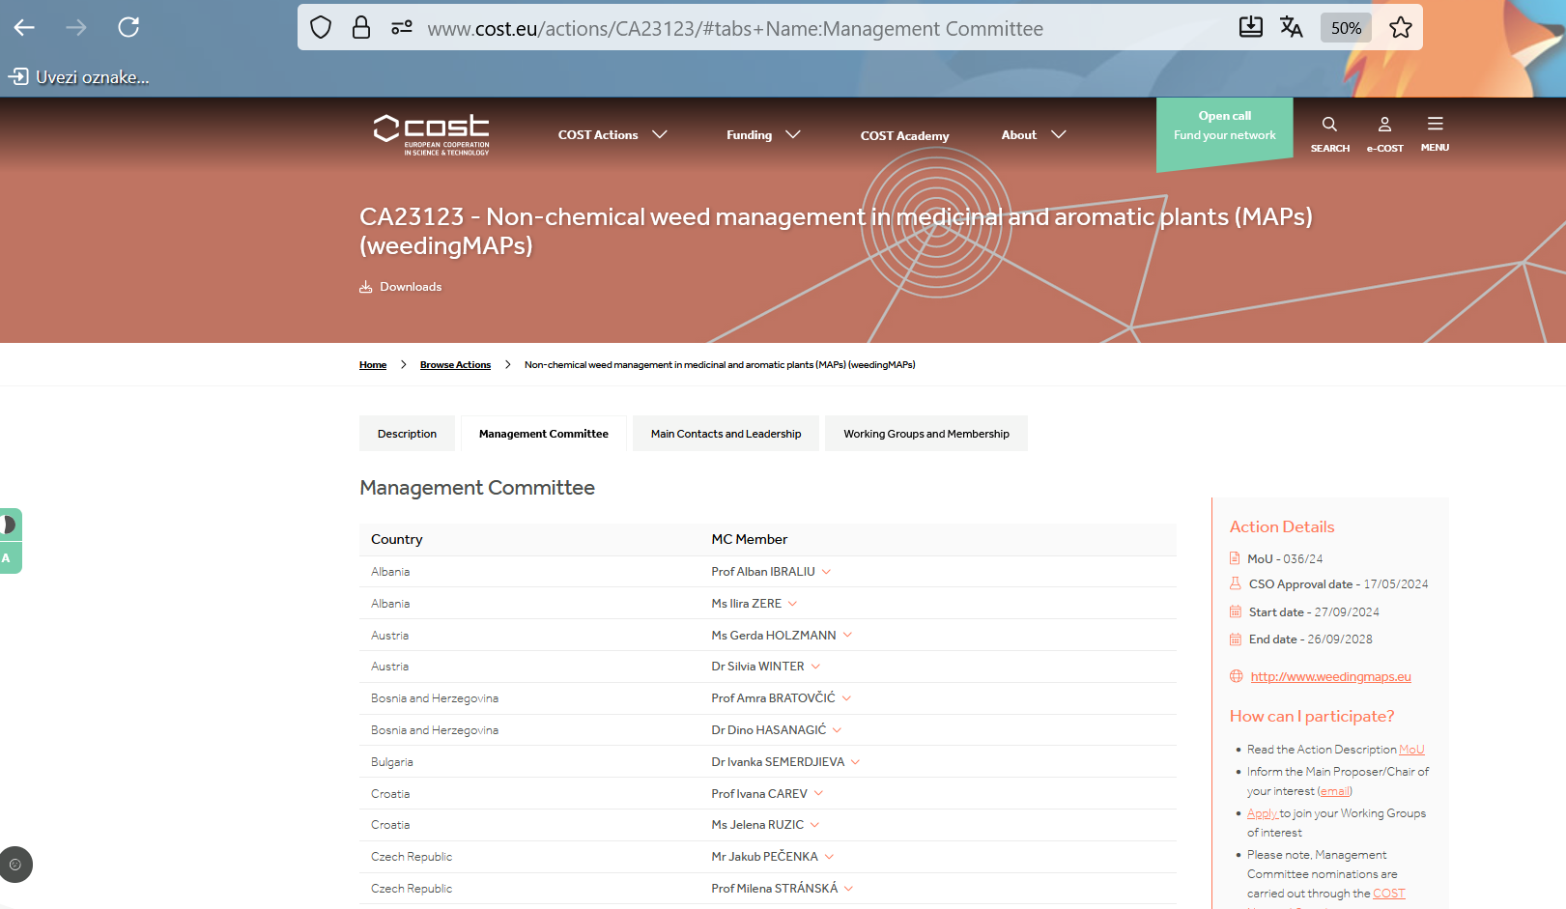

Slide 12
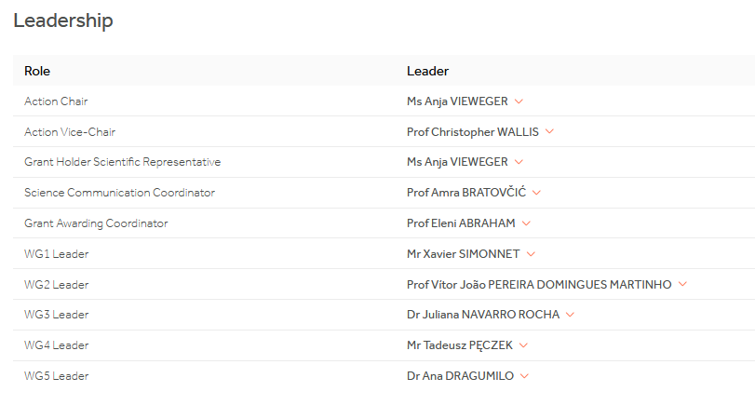
Leadership

Slide 13
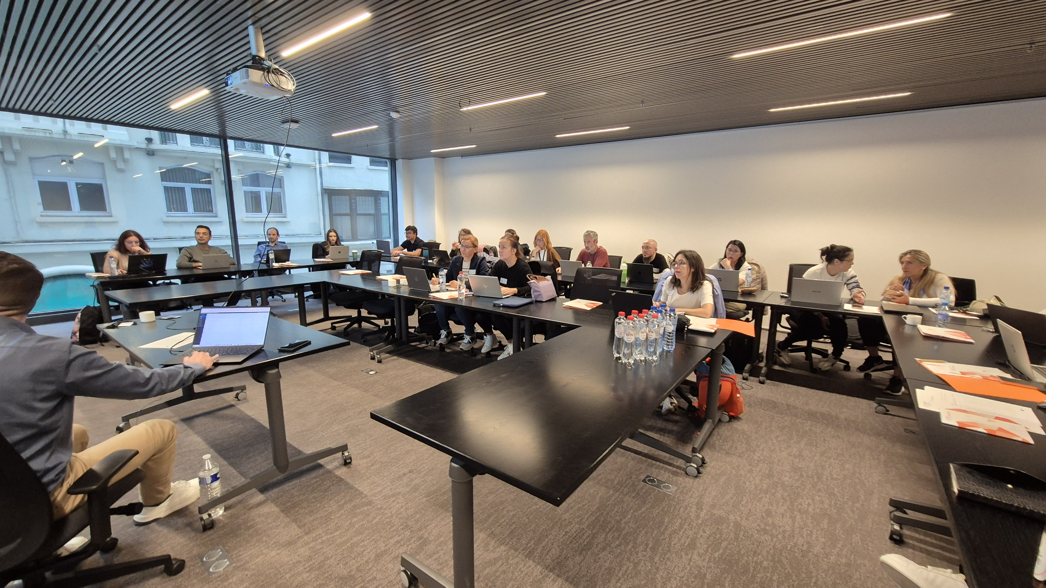
Cost Academy for SCC in Brussels

Slide 14
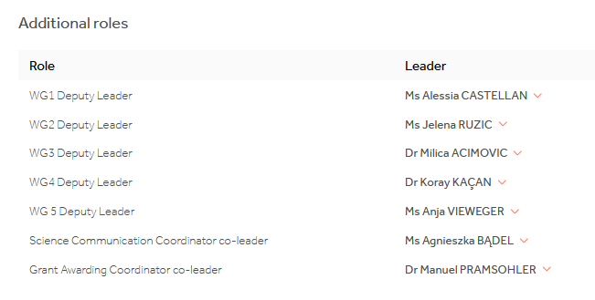

Slide 15
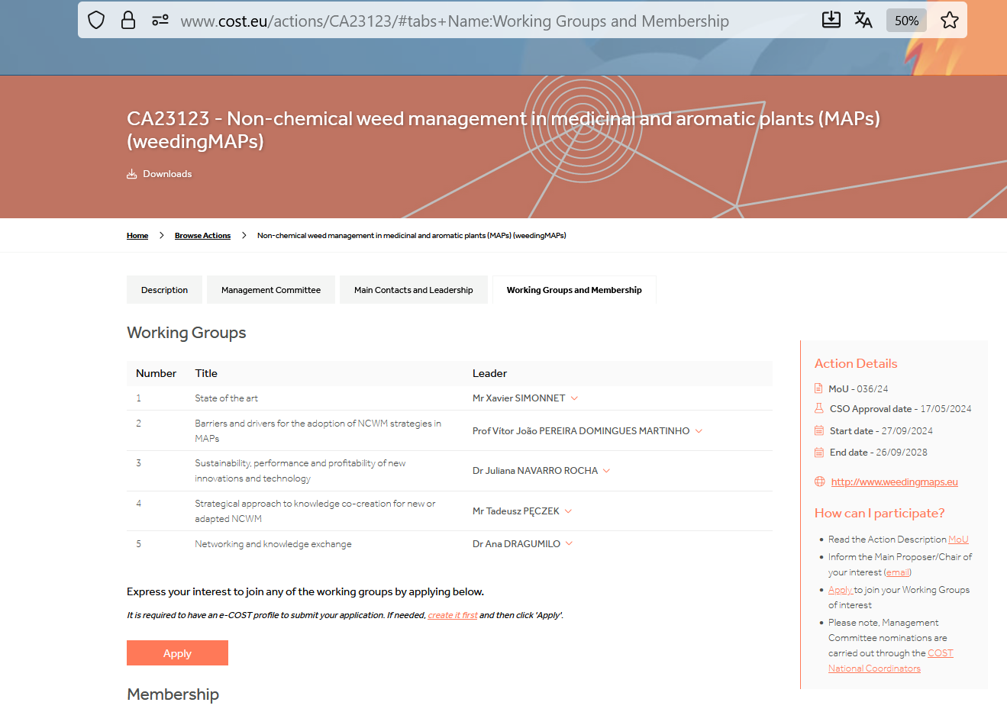

Slide 16

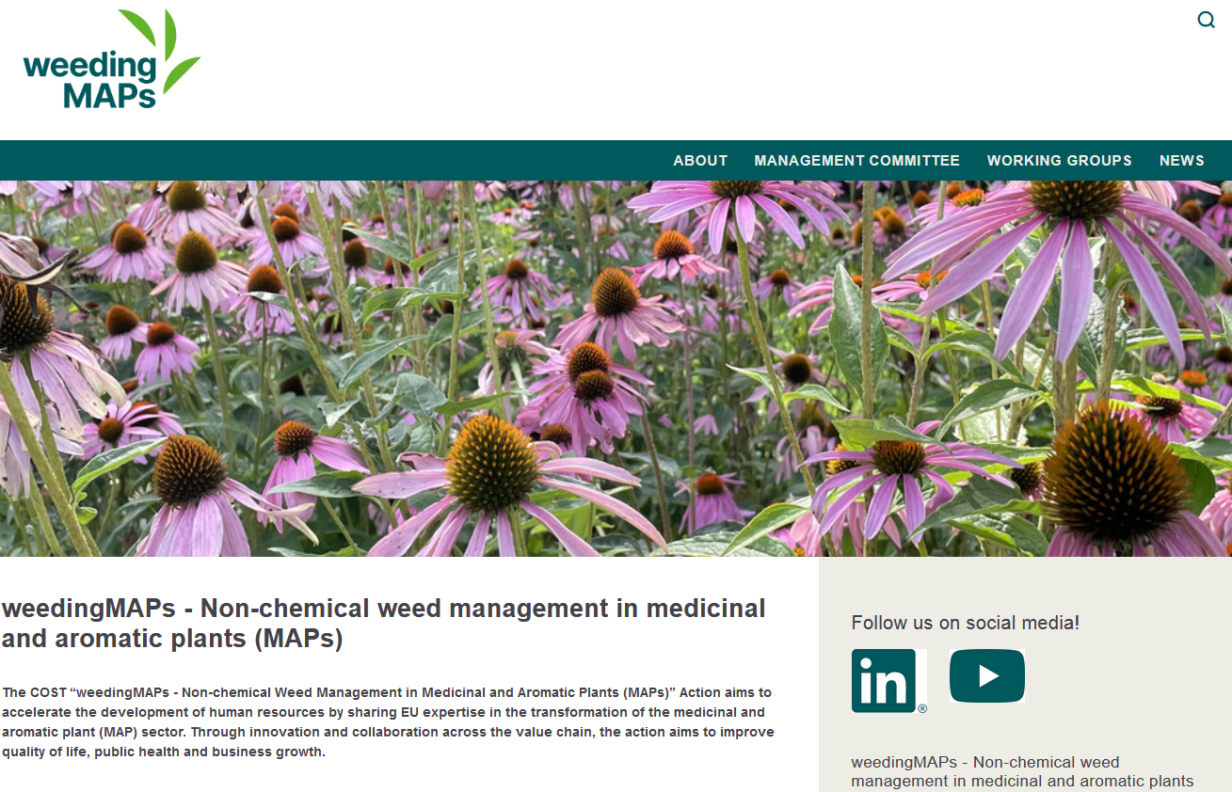

Slide 17

My roles in the projects
WG1. State of the art
WG3. Sustainability, performance and profitability of new innovations and technology
WG5. Networking and knowledge exchange

Slide 18
KNOWLEDGE CREATION, TRANSFER OF KNOWLEDGE AND CAREER
DEVELOPMENT
Knowledge creation
CA fosters knowledge creation through a methodical and strategic approach by:
Mapping existing networks across the MAP value chain (regional, national, international)
Engaging stakeholders in co-creation & co-design workshops
Designing collaboration models and defining principles for cooperation
Establishing partnerships for long-term collaboration beyond the Action

Slide 19
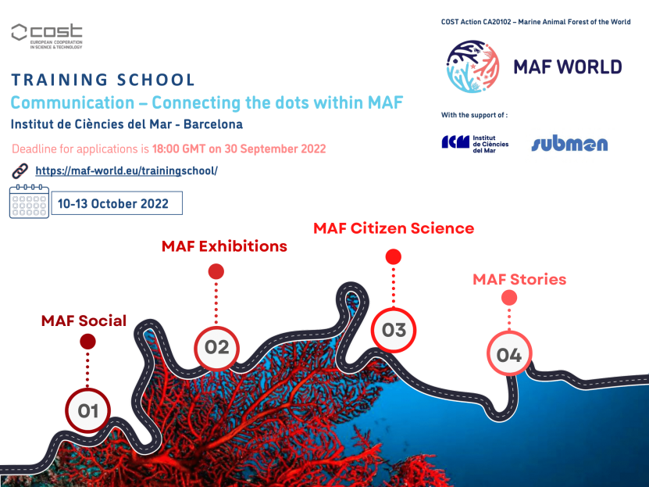


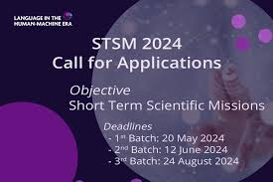
Career development
Training Schools
Short-Term Scientific Missions (STSMs)

Slide 20
Career development
❶
Training Schools
Duration: 2–5 days, public events
Combines theory and practical excursions (farms, processors, machinery companies)
Strong cooperation with universities to attract students and young scientists
Focuses on:
Engaging early-career researchers
Building networks across the MAP sector
Enhancing skills for multidisciplinary, systems-based research
❷
Short-Term Scientific Missions (STSMs)
Duration: 2–4 weeks
Exchanges between institutions and working groups
Intensifies research cooperation and design
Promotes mobility of young scientists, especially from Inclusiveness Target Countries

Slide 21

NETWORKING
Networking is an excellent way for individuals at every stage of their career
to discover exciting opportunities,
meet new connections, and
broaden personal research horizons.
CAs are designed to maximise networking possibilities

Slide 22
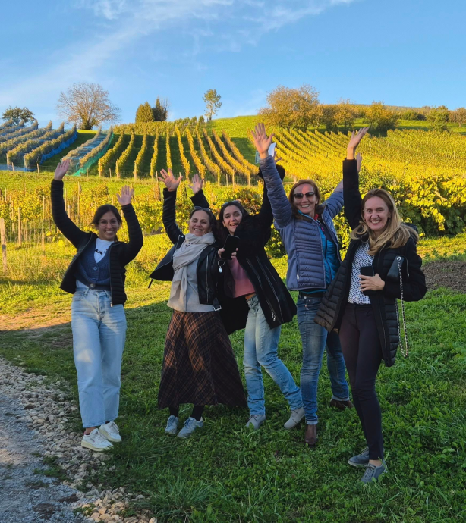
Action Networking tools
Meetings, workshops, and conferences
Meetings are organised by COST Action Management Committees (MC) in any COST Member Country joining the network.
MC meetings, Working Group meetings, workshops, or conferences.
They may be open to the wider community and provide opportunities to enhance the COST Action’s visibility.
COST will contribute to the travel and subsistence costs of invited participants, and to the cost of organising the meeting.
1st in-person Core Group Meeting of COST Action CA23123 took place on 2-3 October 2025 at the Research Institute for Organic Farming (FiBL) in Frick, Switzerland.
Frick, Switzerland, FIBL

Slide 23
Action Networking tools
Short-Term Scientific Missions (STSMs)
visit an institution or laboratory in any country in the world.
2000 are funded every year.
The aim is to foster collaboration and share new techniques and research infrastructure that may not be available in a participant’s home institution or laboratory.
a good opportunity for both young and experienced researchers looking for mentoring and lifelong learning.
enhancing research collaboration.
improved research quality,
expanded research topics,
new projects and proposals,
data sharing, and
strengthened connections are just some of the benefits that emerge.
Further information on the study can be found at the provided link
https://www.cost.eu/cost-actions-event/action-networking-tools/

Slide 24
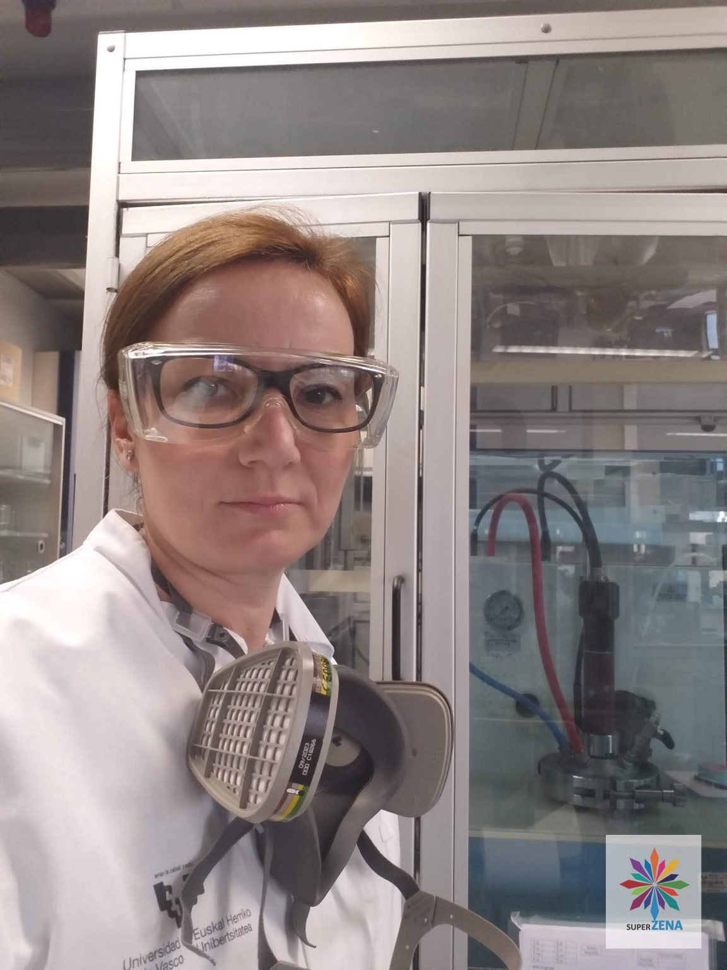
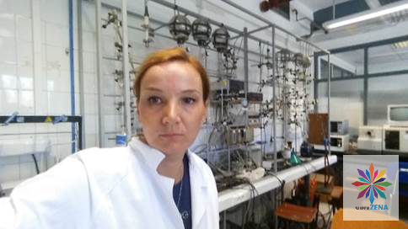

Slide 25
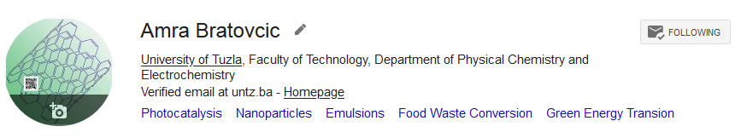
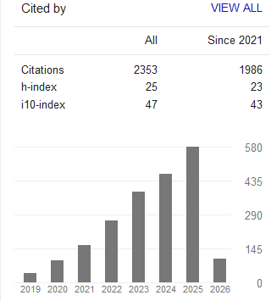
h-index: 25
i-10-index: 47

Slide 26
Action Networking tools
Training Schools
Training Schools offer intensive training on an Action topic at the premises of one of the Action participants.
Trainees are typically Young Researchers and Innovators from across Europe but participation can be open to researchers from any career stage, providing lifelong learning opportunities.
Conference grants
There are two types of conference grants offered by COST Actions, one specifically for Young Researchers and Innovators (under 40 years of age), and another for researchers located in Inclusiveness Target Countries.
The purpose of the grant is to help individuals attend beneficial international conferences that are not organised by the COST Action.

Slide 27
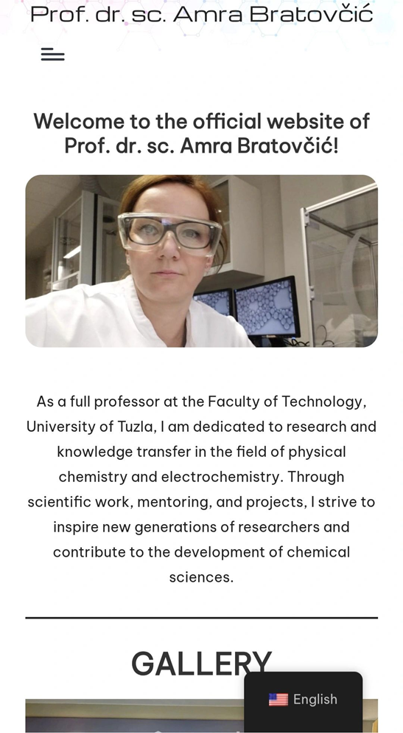
Action Networking tools
Communication and dissemination grants
The sharing of scientific results is vitally important in strengthening science and research.
COST actively encourages and supports Actions to share outcomes with researchers, policymakers, the private sector and civic society such as NGOs.
Virtual Mobility Grants
To respond to the rising need of digital tools and online collaboration, COST Actions also offer Virtual Mobility Grants.

Slide 28
Exploring the Opportunities
Offered by COST Projects
Prof. dr. Amra Bratovcic
Science Communication Coordinator
https://amrabratovcic.com/
CA23123
Non-chemical weed management in
medicinal and aromatic plants (MAPs) (weedingMAPs)
University of Tuzla, 09.03.2026.
Tuzla, Bosnia and Herzegovina

